Slide 1
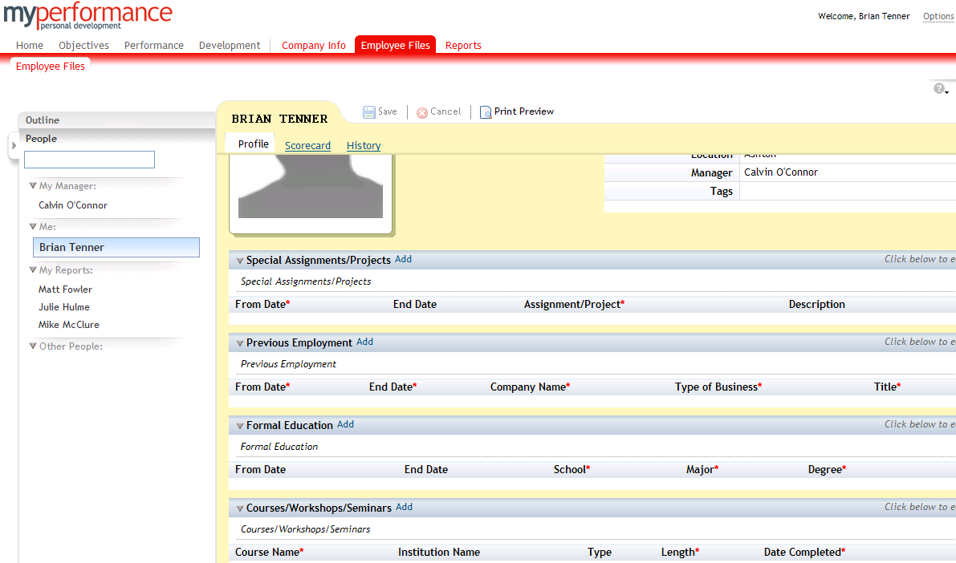
Exploring the Employee Files Tab
Click edit to upload an individualised photo
Complete the blank fields and click the Add button in the header section of each category. Click Save at the top of employee section

